Slide 1


By: Siya Agarwal

Slide 2
Highlights
Acquisition of Endy
Aftermath of COVID-19
Expanding Accessory Offerings
Experiential Brick and Mortar Stores
Conscious consumerism
Notes:
Speaking Notes:
Sleep Country acquired online Mattress-in-a-Box-retailer Endy in 2018. The brands are to remain separate, and it is important to consider brand differentiation between them to prevent cannibalization of sales.
Sleep Country’s newest branding campaign focuses on being a total sleep solution provider. There is a new trend of high tech sleep accessories/wearables to monitor sleep patterns that could be important to include in the product line.
COIVID-19 will have significant impacts on consumer patterns(both during and after). First there will likely be a recession after the pandemic and reduced expenditure on luxury items (like mattresses). Secondly both during and after the pandemic is over there is likely to be increased health/sanitation concerns and heavier reliable on digital platforms while shopping.
Declining trend of Brick and Morter retail stores. Many stores have closed their physical presence (eg Forever 21), and instead moved operations online. New Brick and Morter stores that do open and succeed so so by transforming the retail experience into an interactive, experimental one (eg Glossier showroom in NY) as consumers are keeping more meaningful experiences.
Canadians are increasingly practicing conscious consumerism and have indicated a higher willingness to pay for sustainable products

Slide 3
Further reading on the impact of COIV-19 on consumer behavior can be found here.

Slide 4

1. The Consumer

Slide 5
1.1 Consumer Segments
WHO
Single, Mid -20’s, first time buyer
CONCERN
Transportation of mattress, price
WHO
Family, 20-40yrs, repeat buyer
CONCERN
Changing mattress size needs, quantity, price
WHO
Couple, 40+yrs , repeat buyer
CONCERN
Quantity and Comfort, transportation of mattress
Notes:
The market for mattresses and related sleep products is generally all adults between 23-60 years. They can be further categorized into various segments with different needs and concerns. An additional analysis of demographic trends reveals:
The largest demographic categories in Canada are 55- 59 and 25-29 years (3.7%) (Stats Canada). Thus, currently the young first time buyers and older buyers are important consumer segments. In the future, as the population ages the 20-40year old are likely to make up the largest consumer segment.
Canada has seen steadily decreasing family sizes since the 1950’s with the family size of 2.57 according to the 2016 Census (Stats Canada). This means there may be a higher demand for smaller mattress sizes, and branding needs to be catered to the new “single” demographic.

Slide 6


1.2 Consumer Observations
OPPORTUNITY
THREAT
Conscious consumerism
Increasing Personalization
Increasing Online Retail
Focus on Health & Sleep
Housing Unaffordability
Notes:
Between 2014 - 2015 there was a 10% increase in the number of Canadians reporting they will be willing to pay more for sustainable products (Neilson). This has lead to a new line of sustainable clothing/products such as Parachute in the US that makes biodegradable Mattresses.
There is an increasing trend of personalization of products to suit a users unique needs. This has been reflected in Sleep Country’s Campaign that enables customers to be matches with their perfect bed.
Renewed interest in products that enable wellness such as fit bits, ergometric chairs, and sleep wearables such as rings and wristwatches that monitor sleep. This is a positive trend for sleep country and an opportunity to expand their product line to include devices like Oura rings and CBD gummies.
On the other hand, retail has increasingly shifted online, a trend likely to be be strengthened by COVID-19. This may pose a threat to Sleep country’s many brick and mortar stores.
There is increasing housing unaffordability in Canada for the past few years, and this is likely to worsen in the aftermath of COVID-19. Since housing affordability is correlated with mattresses sales, there may be a decrease in mattress sales in the coming year.

Slide 7

2. The Industry

Slide 8
2.1 Industry Competition
Regional Specialty Mattress Retailers
Casper, Parachute, Tuft & Needle, Leesa, Sattva
Rapid growth in competitors over last 10 years.
Sleep Country
Ikea, Best Buy, Costco, Walmart
Biggest Competition:
Online Specialty Mattress Retailers, Low-cost full-line furniture retailers
Specialization
Hudson’s Bay
Amazon
Indigo
Digital Retail
Notes:
Over the past 10 years, there has been the rapid increase in mattresses retailers. Sleep Country’s competitors can be classified by their level of specialization and digital presence.
First there are generalized departmental stores such as Hudson’s Bay and Indigo. These are often partners with Sleep Country and not their direct competition.
Second, there are low-cost full-line furniture retailers such as Ikea, Best buy, Costco and Walmart. They sell a variety of furniture and are in direct competition with Sleep Country.
Third, there are regional specialist mattress retailers that provide specialized mattresses to their municipalities. They are small in scale and do not provide much competition.
On the other side, there are online retailers. Amazon is the dominant generalized online retailer that customers buy mattresses from. This is not in direct competition with Sleep Country.
Lastly, there have been a surge on online specialty mattress retailers such as Casper, parachute, Tuft, Needle etc (primarily in the states, but likely to expand geographic reach). These provide very high convenience of buying/returning, are in direct competition with sleep country.

Slide 9

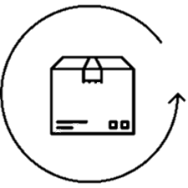

2.2 Industry Trends
Growth of mattress-in-a-box retailers
Ease of trials and returns (often 100% cashback)
Information based decision making (specs, reviews, technology)
Notes:
The growth of these online specialty retailers have been coupled with three major industry trends;
The use of mattress-in-a-box delivery such that it is easy to package and transport mattresses. This address a lot of the transportation concerns first time, young buyers have. Sleep Country does offer this through its Bloom Mattress line.
The ability to try a mattress after purchase for a period of time to ensure consumer satisfaction. This ease is not offered by Sleep Country that currently only offers exchanges (no cashback). A scan of reddit posts reveals that this process is rather cumbersome and there is some customer dissatisfaction related to the return/exchange process.
Increased transparency about the product specifications, information about different materials and technology, and “science based” reviewed. This has been bolstered by mattress review websites that customers reply on when making decisions.

Slide 10
2.3 Inspirational Campaign
Casper Transit Campaign
Notes:
One excellent eye catching mattress campaign is Caspers’ transit campaign. It forces users to think and interact with the advertisement and thus captures their attention for a longer time.

Slide 11

3. The Brand

Slide 12
3.1 Brand Performance
31%
Canadian mattress Market Share
49
Stores opened, removed and relocated (17 new) in 2018
Stagnant
Stock price since decline in September ’18*
* Drastic recent decline due to COVID-19 Pandemic
Notes:
The brand has performance relatively well in the past year.
It enjoys a 31% market share in the Canadian mattress market.
Sleep Country opened and renovated a combination of 49 stores in 2018. This includes the opening of 17 new stores, 4 of which were in enclosed malls. I would caution against brick and mortar expansions as they is likely to decline in the coming years. Instead, there is the opportunity for many of these stores to be transformed into experiential stores for customers to try producst (as opposed to being a main point for sale). This analysis is strengthened by a decrease of 0.2% in sale store sales last year.
Sleep Country’s stock price decreased in September 2018 following the release of disappointing quarterly earnings. This stock price has not rebounded since then. Recently with the COVID-19 crisis stock prices have plummeted, but this is anticipated to be a short term decline. This overall indicates declining inverstor confidence in traditional mattress retailers.

Slide 13
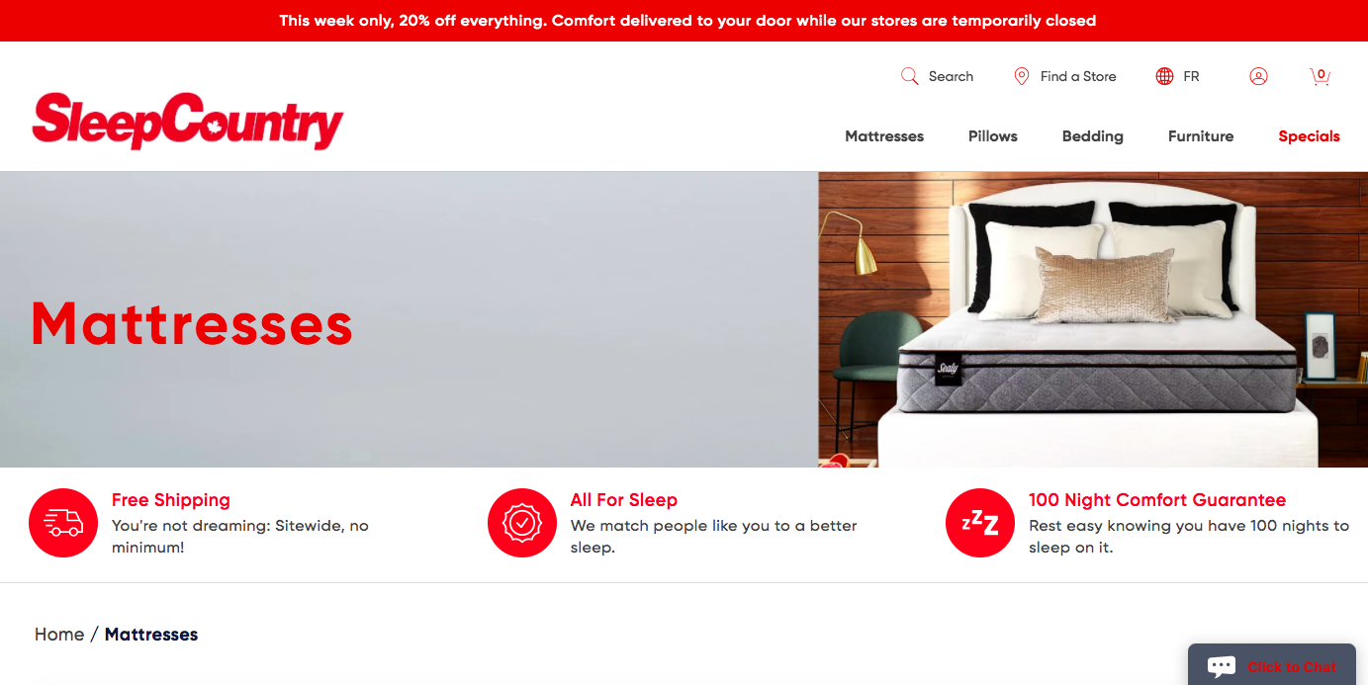
3.2 Brand Observations
Endy Acquisition for $89 million
Partnerships with Simba, introduction of Bloom mattress line
New ecommerce platform and potential for improvements
Notes:
Sleep country has introduced several initiatives to keep up with the rapidly changing industry including;
1. The acquisition of Endy in 2018. This enabled Sleep Country to significantly increase their online reach while retaining their “Canadian” identity. There must be consideration for Endy’s primary market and a need to differentiate from this market such that the companies do not cannibalize sales from each other.
2. The introduction of new partnerships with mattress-in-the-box companies such as Simba has enabled them to expand their product selection. There is the opportunity to increase partnerships with sleep accessory products.
3. The launch of Sleep Country’s new ecommerce platform for online shopping. There is the potential for improvements to the branding of this website.

Slide 14


